Slide 1
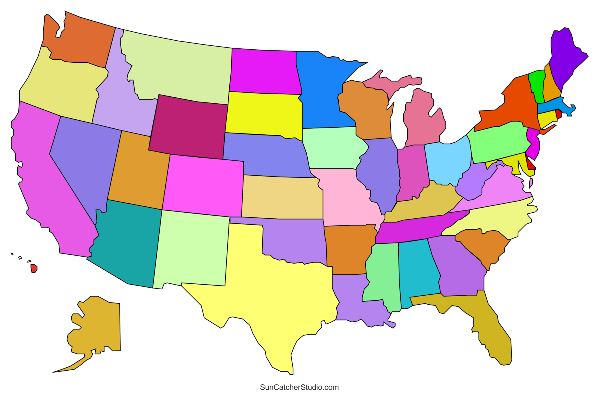
My path to BRI!
7 24 2024
Ty Bottorff
Notes:
Should be 30 min, keep timer on to track as I go

Slide 2

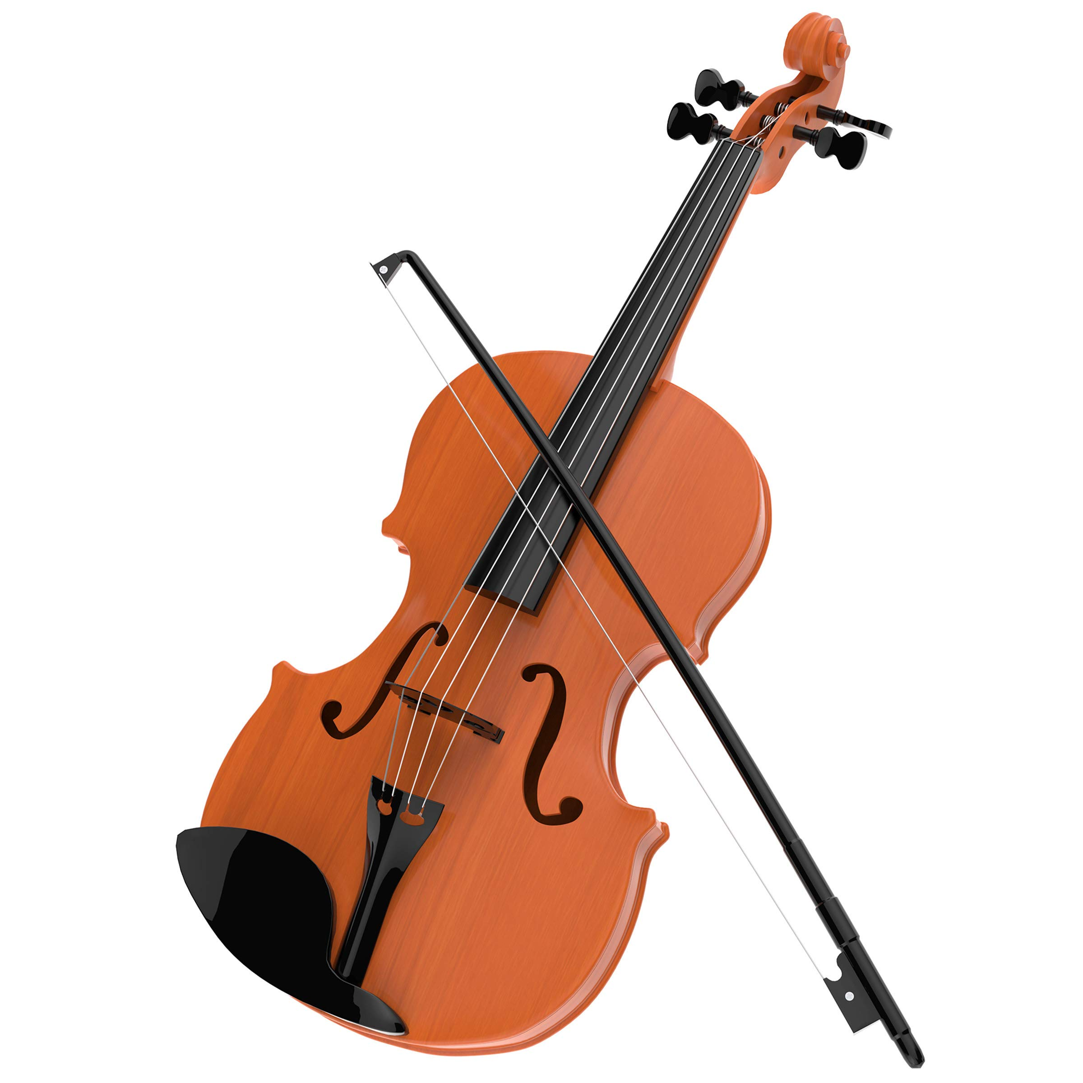

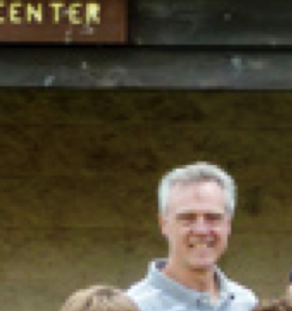
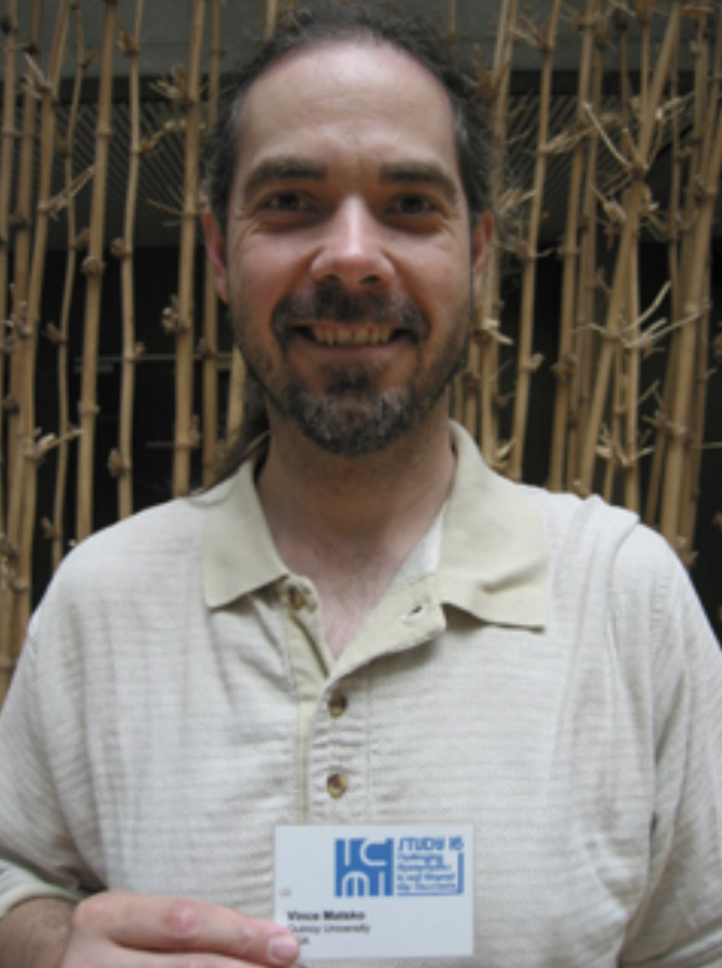
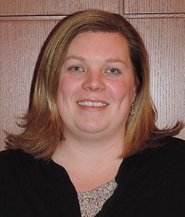

Childhood interest in STEM
Mom (electrical engineer)
Extracurriculars
Inspiring teachers
Mr. Allen
Ms. Detzler
Dr. Matsko
Dr. Schrementi
Notes:
Elementary school teacher told my parents I was good at math → Mom supplemented my education with algebra teaching at home → went to DaVinci/IMSA

Slide 3
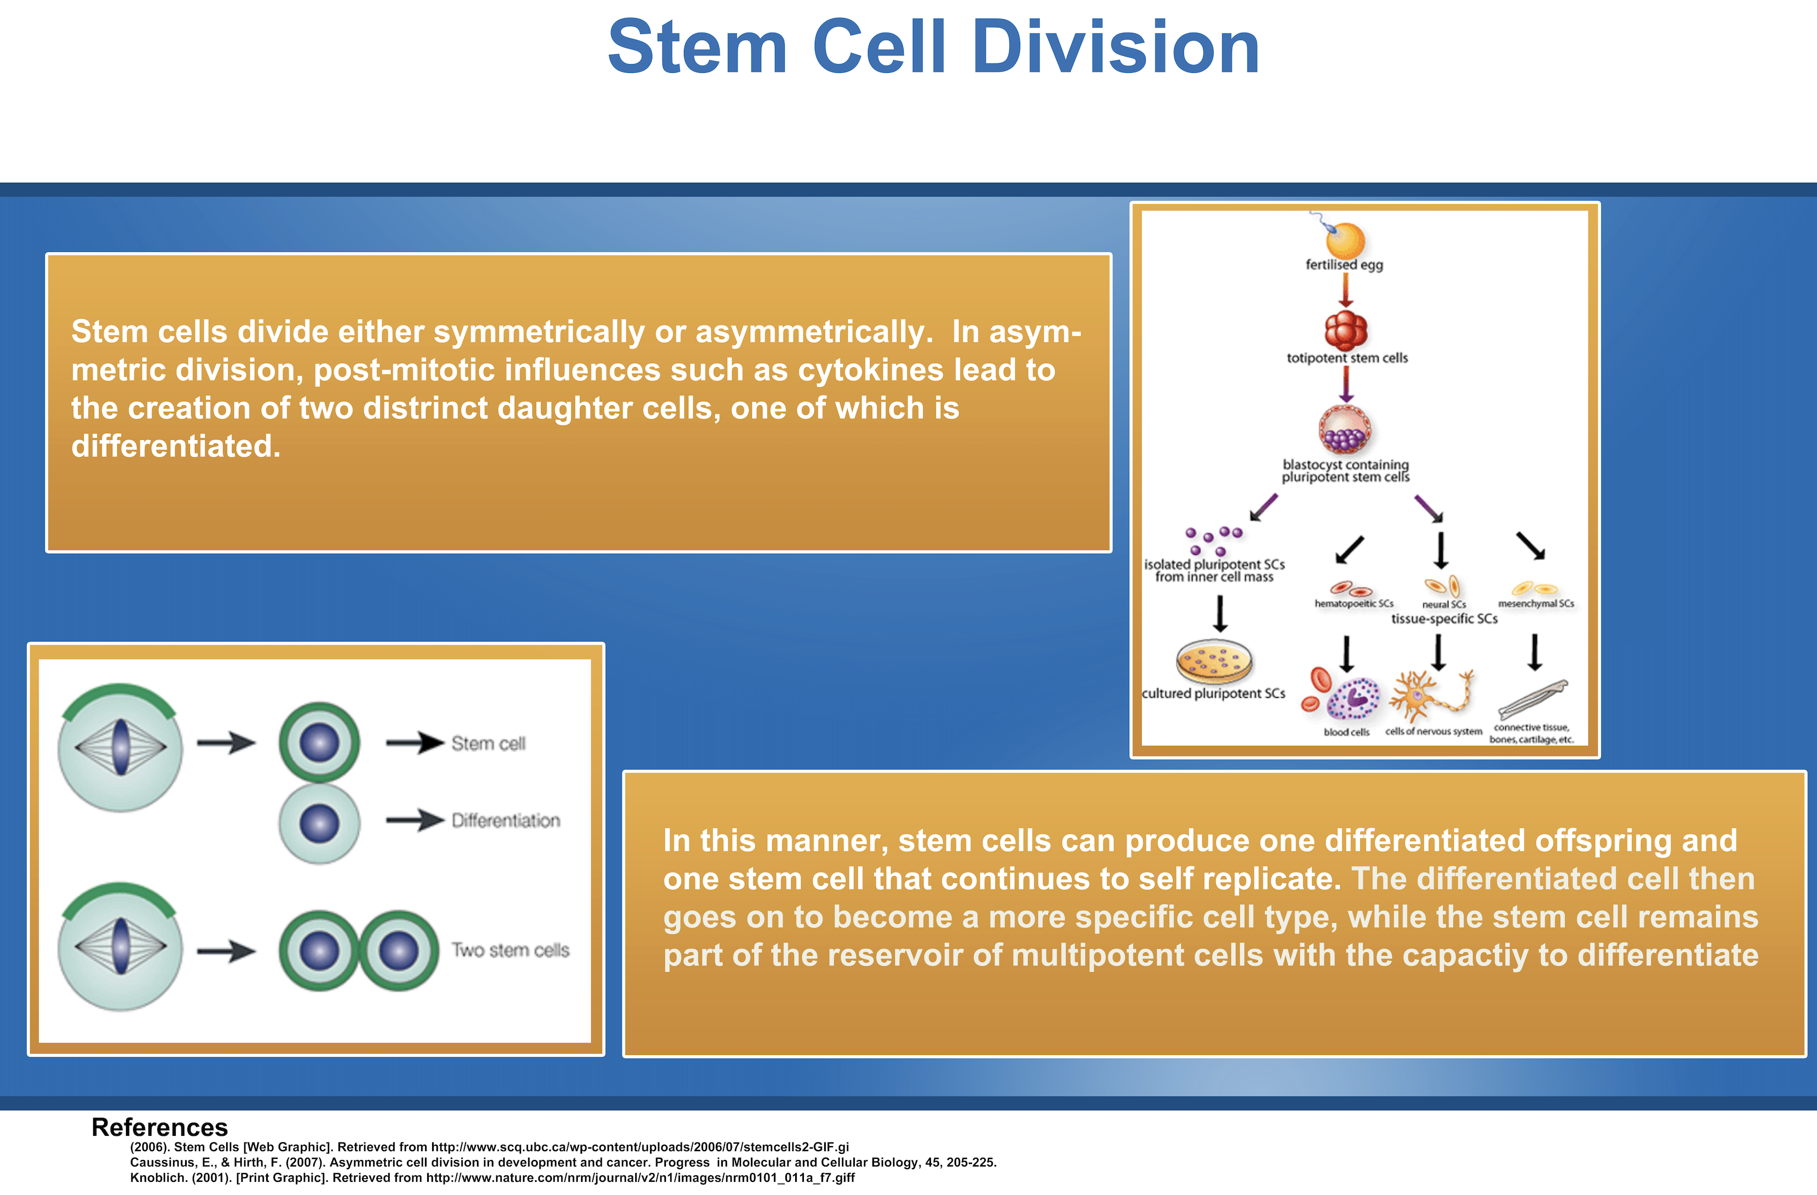
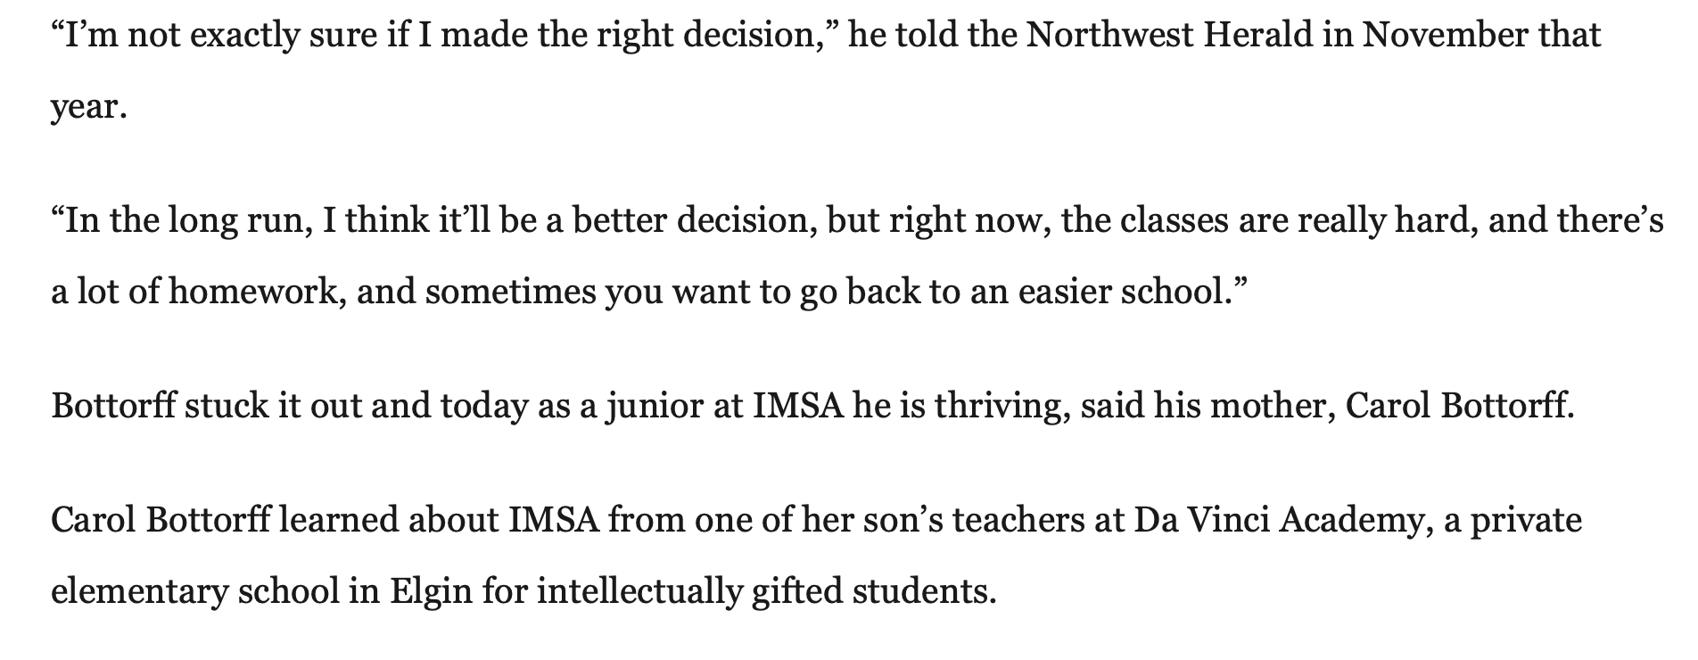
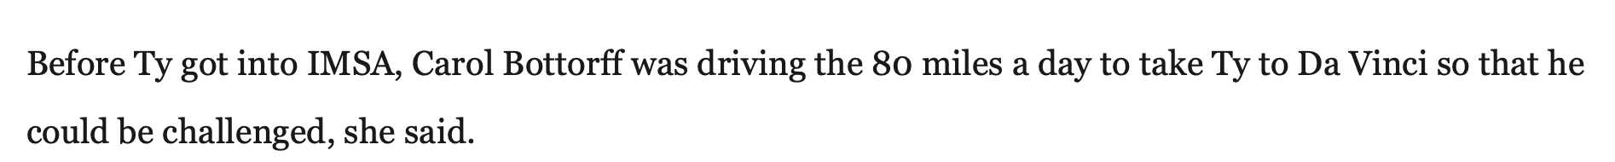
Illinois mathematics & science academy (high school)
Unique STEM courses
Research day Wednesdays
Tutored STEM classes, enjoyed education

Slide 4
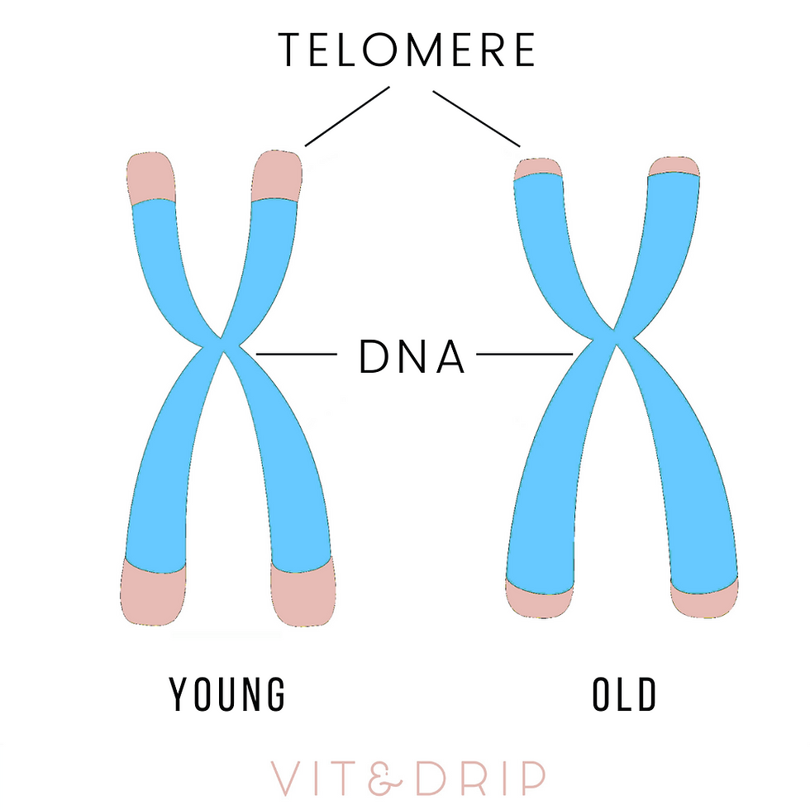
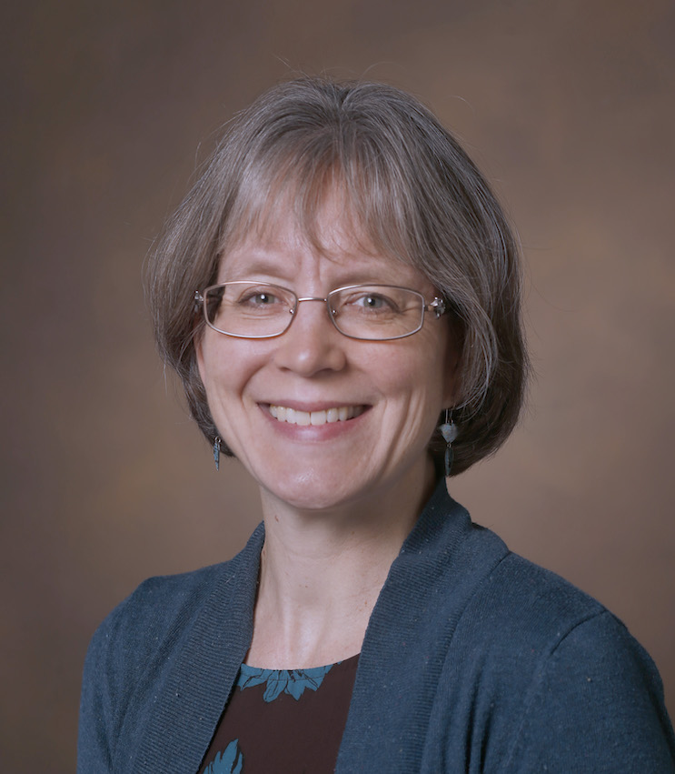
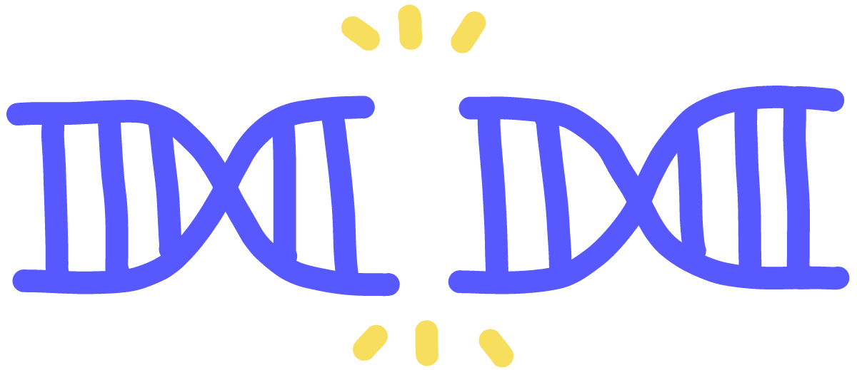
Vanderbilt (undergrad)
Majors: secondary Education & molecular & cellular biology
Goal: teaching high school, tutored student athletes
Research in Friedman lab (to inform teaching)
Grad student had previously found an endogenous hot spot of de novo telomere addition in the yeast genome
My project: CRISPR/Cas9-based system to search for more sites in yeast genome that encourage telomere addition in response to double stranded breaks
Dr. Friedman
Notes:
Vanderbilt because I got a good scholarship

Slide 5
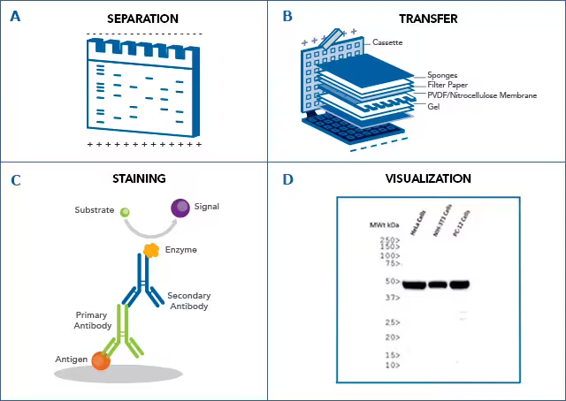
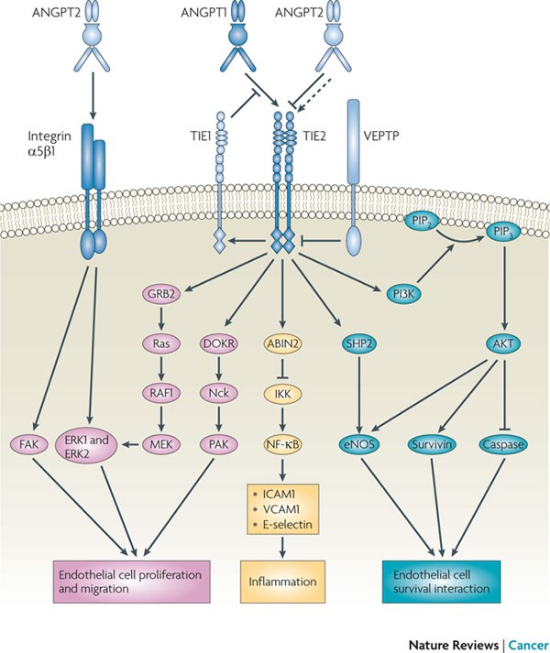
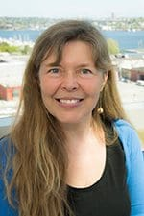
UW for post-bac in Ruohola-Baker lab
Goal: PhD to be able to (maybe) teach college, needed more experience to be competitive for grad school apps
Research projects
Tie2 clustering and downstream signaling (branch preference) in human umbilical vein endothelial cells using designed protein scaffolds
mTORC signaling in human stem cells
HIF2α detection and screening for CRISPR KO in human stem cell line
Dr. Ruohola-Baker
Notes:
UW because PNW + queer (all other post-bac options were in south)

Slide 6
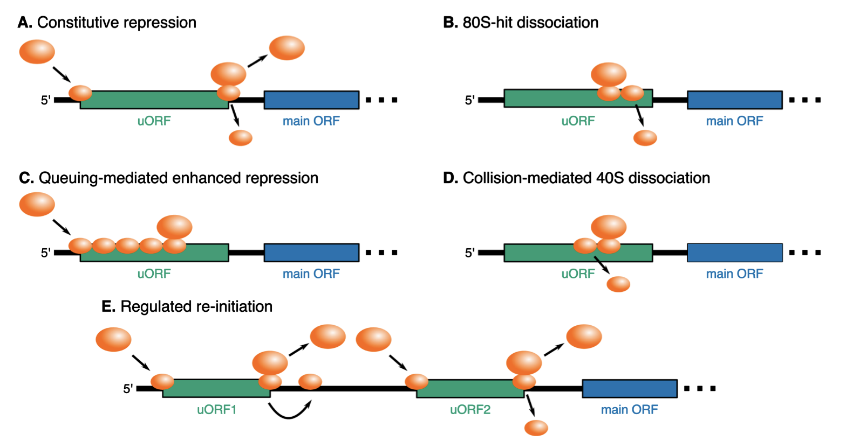
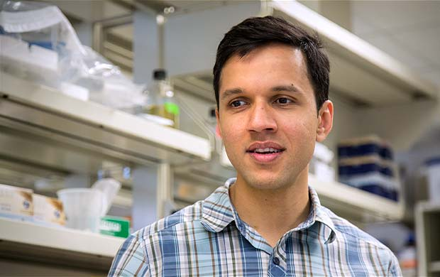
UW for grad school (biological physics, structure & design program) in Subramaniam lab: studying translation in 5’ untranslated regions
Why UW BPSD?
Wanted to stay in Seattle
Dr. Subramaniam
Notes:
Applied all over west coast but spam applied UW programs!
uORF-mediated regulation of translation
Intro:
~1/2 of human mRNAs have > 0 uORFs in 5’ UTR, ~20% are translated, implicated in human disease (for example cancer)

Slide 7
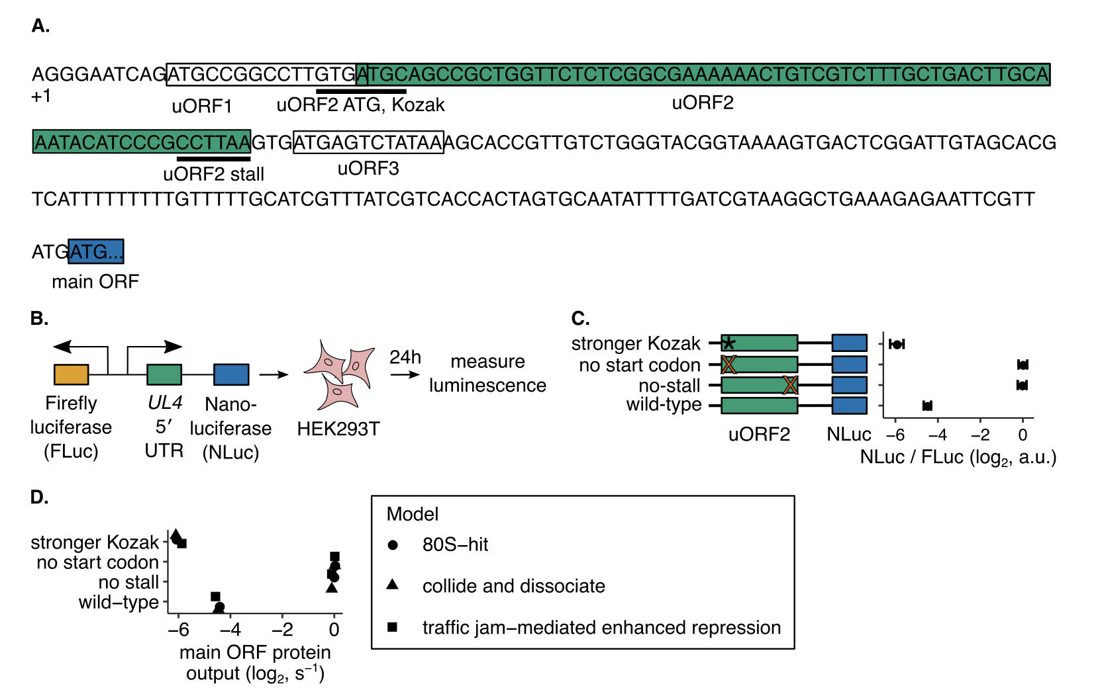
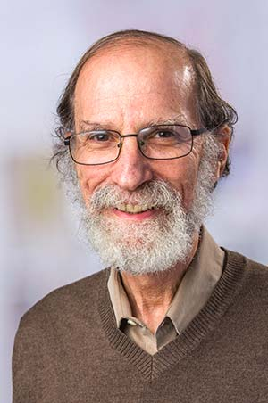
Experimental system using cytomegaloviral UL4 5’ UTR to be able to assess the impact of 5’ UTR mutations on main ORF protein output
5’ UTR sequence
Dr. Geballe

Slide 8
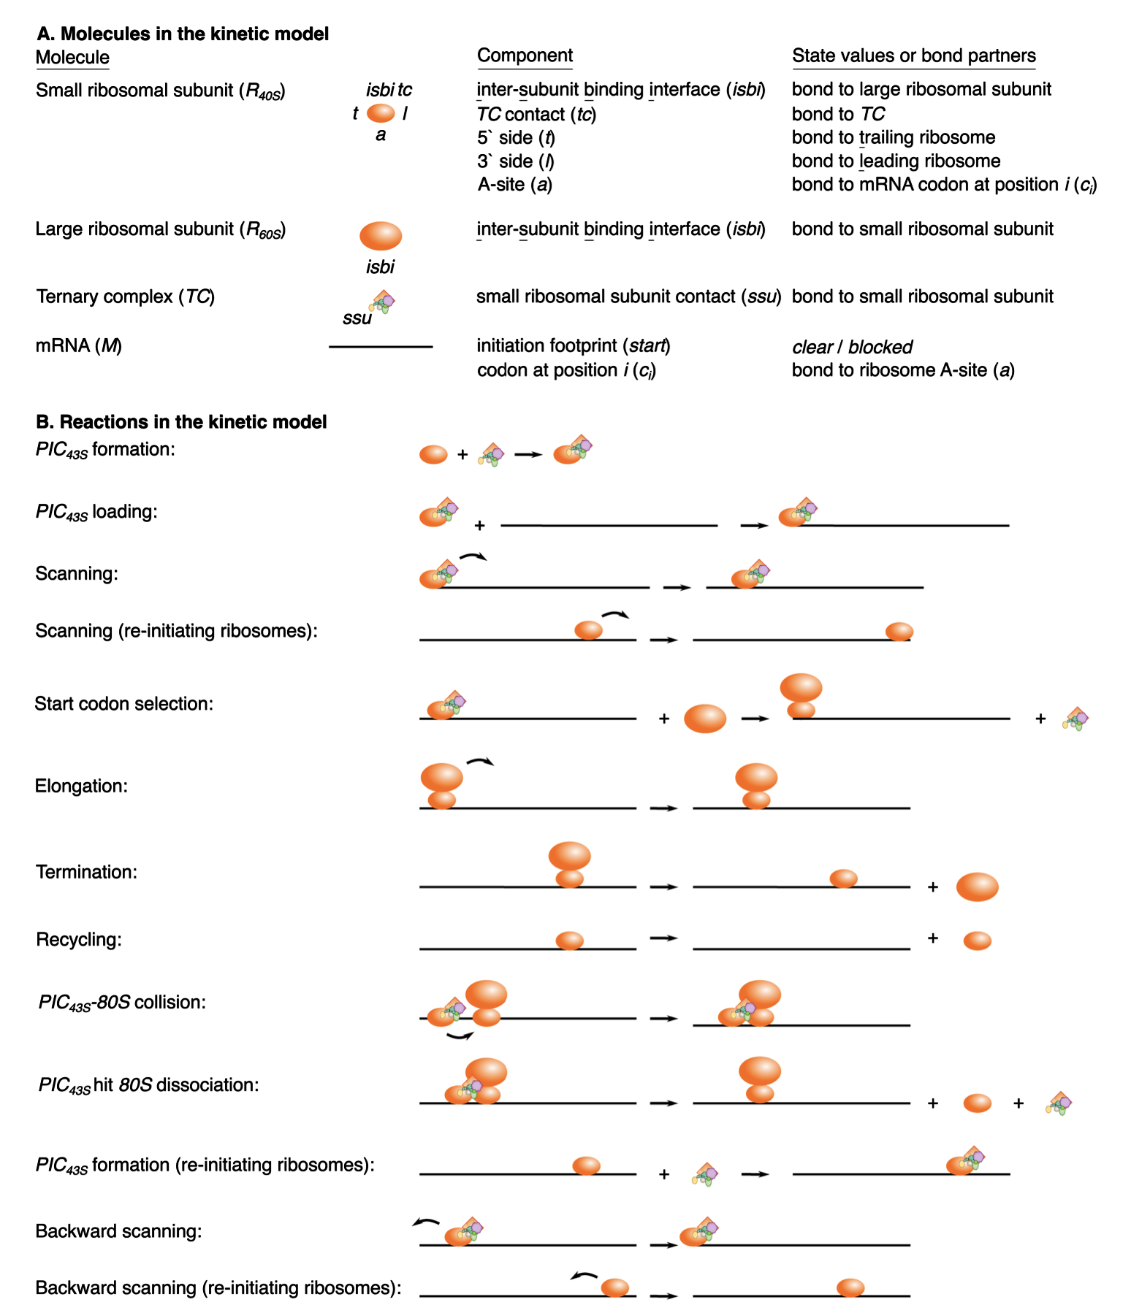
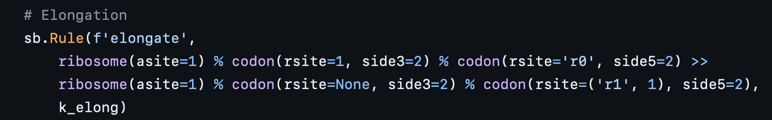
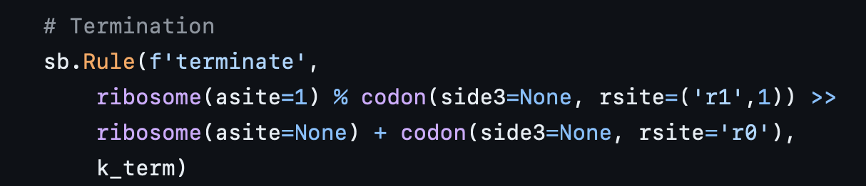
Agent-based stochastic simulations to predict protein output in silico
Notes:
We specify our kinetic models using the PySB interface [58] to the BioNetGen modeling language [59] (Fig 3). The Python script is parsed by BioNetGen into a.bngl file and converted into an xml file for use as input to the agent-based stochastic simulator NFsim [60].
Agent-based modeling meaning the molecules here are “agents”

Slide 9
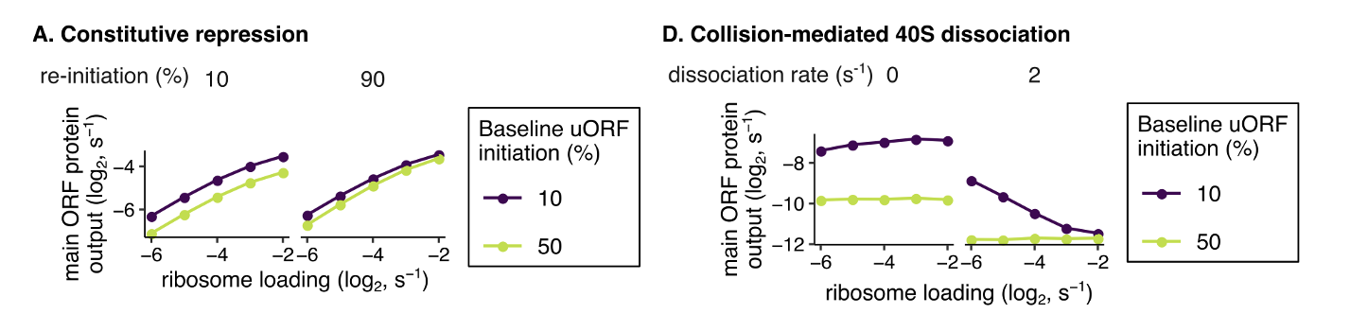
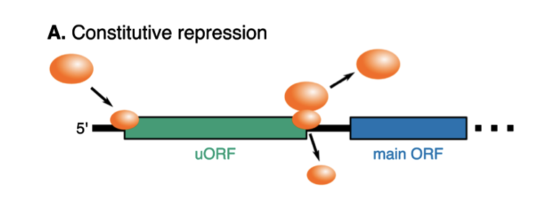
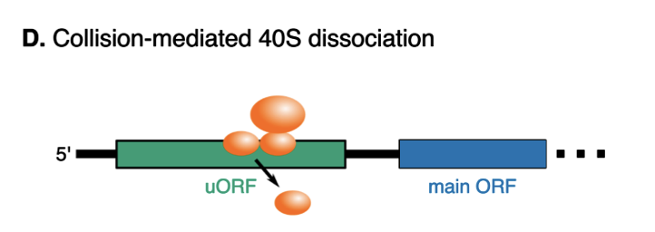
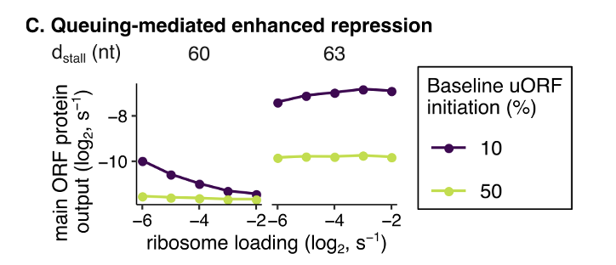
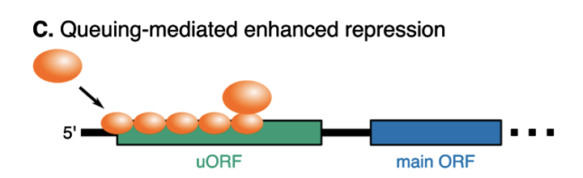
Some models are computationally predicted to allow “buffering”, different parameters important for “buffering” in different models
Notes:
Lots of R (tidyverse) for data analysis!

Slide 10
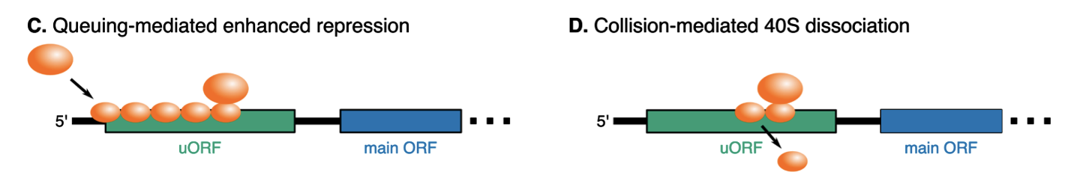
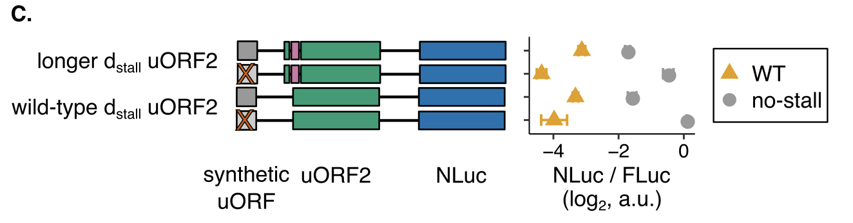
Experimentally observe buffering that is independent of d_{stall}, consistent with the with the collision-mediated 40S dissociation model and inconsistent with the queueing model

Slide 11
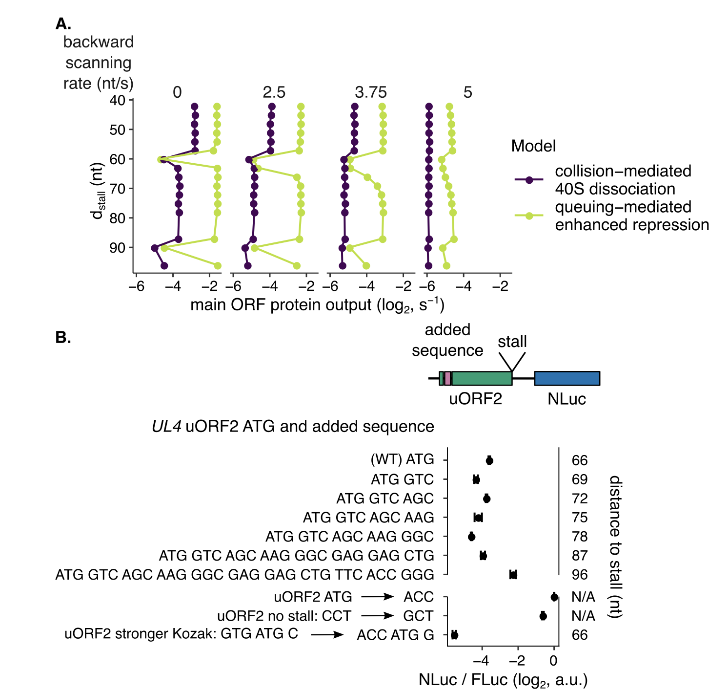
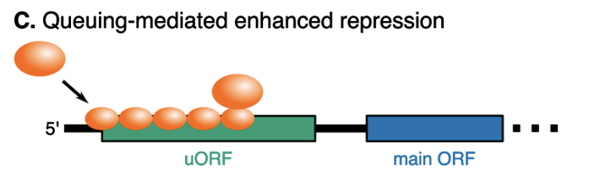
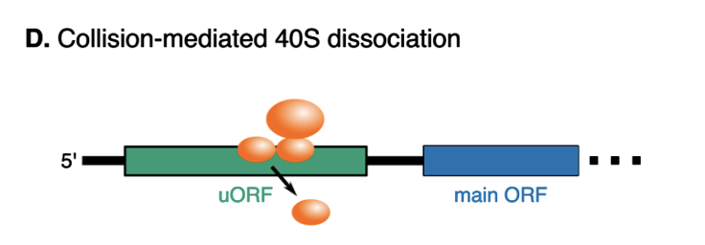
d_{stall} also doesn’t matter much for uORF repressiveness, more consistent with the collision-mediated 40S dissociation model than the queuing model

Slide 12
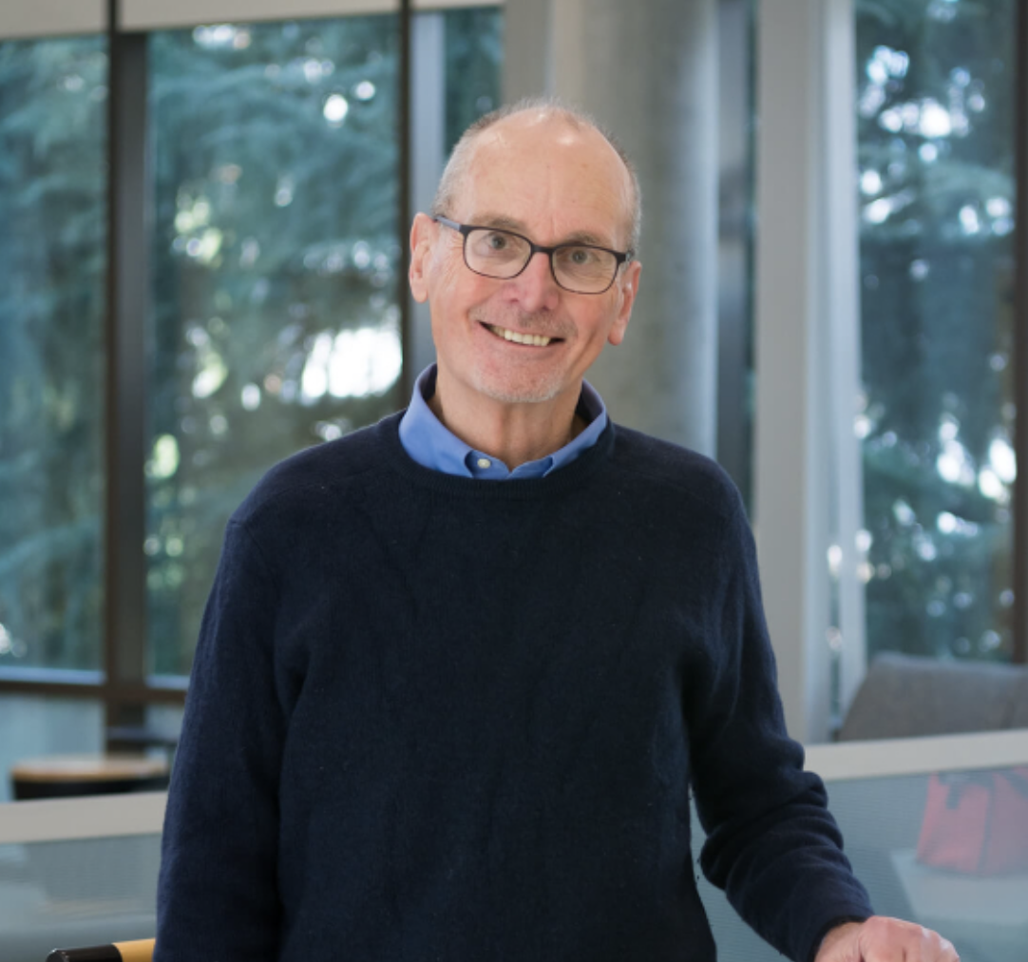
Bioinformatics postdoc at BRI in Linsley lab
Why BRI bioinformatics postdoc?
enjoyed computational analyses much more than wet lab experiments
wanted to work more in human biology sphere (PhD was basic science)
wanted to stay in Seattle
Project 1: investigating subsets of exhausted T cells in type 1 (autoimmune) diabetes
Dr. Linsley
Notes:
Wanted to stay in Seattle, enjoyed data analysis and NOT experiments
Computational investigation of RNA and TCR differences between patients who do and do not develop immune-related adverse events (irAEs) from cancer immunotherapy

Slide 13
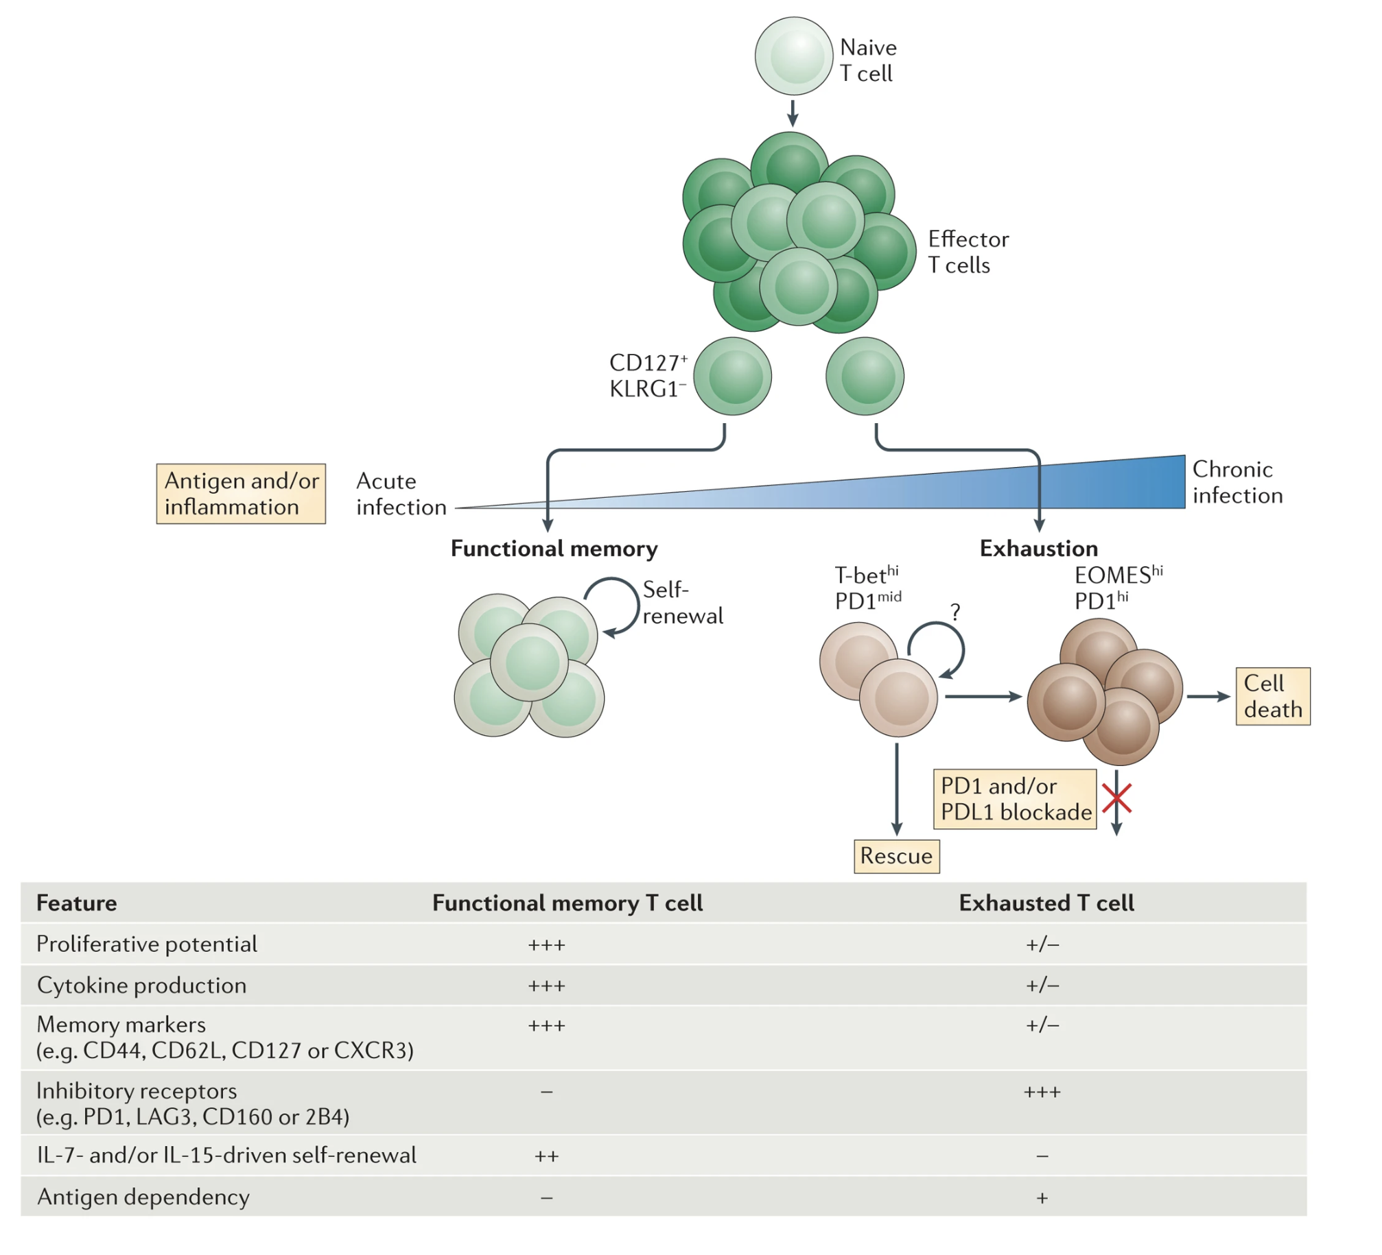
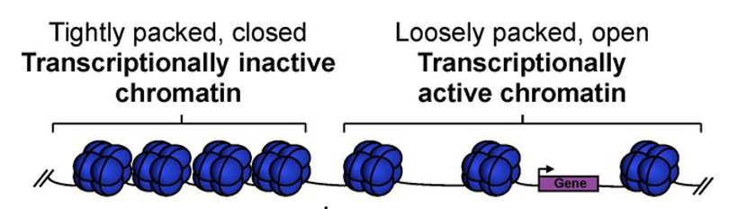
T cell exhaustion results from chronic antigen stimulation, inability to fully clear antigen
Specific epigenetic changes associated with T cell exhaustion
Wherry & Kurachi. Nat Reviews Immunol. 2015
Notes:
Autoimmunity still results likely because affinity between antigens and TCRs are low, so T cells don’t become overly exhausted (i.e. higher affinity TCR-neoantigens more strongly stimulate T cells and exhausts them)
With weakly stimulated but chronic antigens, T cells don’t exhaust (i.e. autoimmunity)
So in case of autoimmunity Tex is great, in case of cancer it associates with worse response
3 signal model for exhaustion: persistent antigen exposure, negative costimulatory signals, chronic inflammation
Evolutionary reason for Tex could be to minimize self-tissue damage with still controlling antigen somewhat
More and more exhaustion leads to terminal exhaustion & apoptosis

Slide 14
Levels of exhausted T cells (T_{ex}) are a biomarker in type 1 diabetes
Higher levels of (partial) T_{ex} (TIGIT⁺ KLRG1⁺) CD8s associated with
slower progression to T1D
beneficial response to therapy in at risk for and new onset T1D
Higher levels of TIGIT⁺KLRG1⁺CD127⁺ CD8s associated with worse outcome
Figure 2. Individuals with high levels of different Tex subsets vary in their clinical outcomes after teplizumab treatment. We stratified teplizumab- treated (Active) subjects from the TN-10 study having high (above third quartile) or low (below third quartile) levels of the indicated Tex subsets at 3 months post-treatment. We then used Kaplan-Meier survival analysis to compare time to T1D progression for these groups. As a negative control, we used as placebo- treated subjects.
Notes:
TIGIT⁺KLRG1⁺ Tex cells here are only partially exhausted (addition of TIGIT ligand further downregulates their activity), and there are more exhaustion markers possibly not + here in T+K+
Teplizumab: first FDA approved therapeutic for T1D therapy!
Teplizumab: humanized anti-CD3 monoclonal Ab to delay onset of stage 3 T1D in people with stage 2 T1D. mechanism: weak agonist of TCR-CD3 to induce anergy/apoptosis of T cells (i.e. autoreactive Teffs I presume)
TEX are heterogeneous, with some TEX associating with better or worse outcome in cancer/chronic infection! So not always positive correlation b/w Tex and intensity of autoimmunity, namely DP CD127+ goes against general DP trend
CD127+ presumably bad because they’re less Tex, CD127 blockade helps T1D outcome by depleting/deactivating TEM
Mice: IL-7–deprived diabetogenic T_{E/M} cells showed increased expression of the inhibitory receptor Programmed Death 1 (PD-1) and reduced IFN-γ production. Conversely, IL-7 suppressed PD-1 expression on activated T cells in vitro.

Slide 15
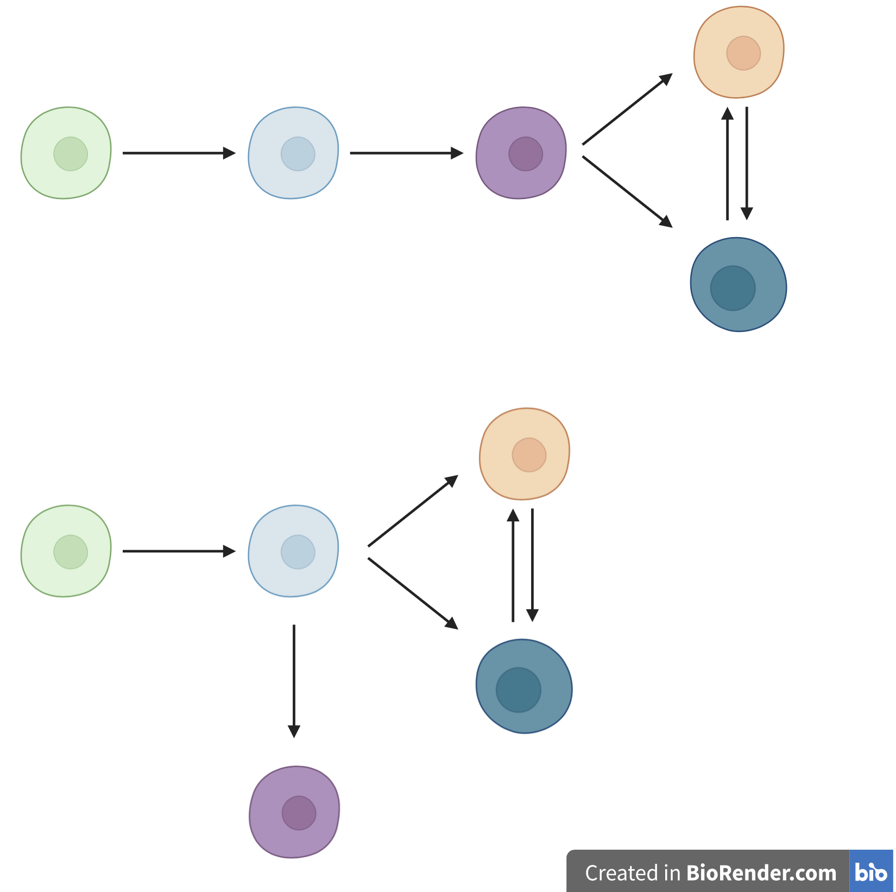
Central questions
Simple CD8 TEM differentiation models
How do the different cell populations’ epigenetic profiles differ?
What insights can we gain into CD8 TEM differentiation paths?
DP PD-1⁺
DP
CD127⁺
TIGIT⁻
KLRG1⁻
TIGIT⁺
KLRG1⁺ (DP)
DP CD57⁺
Notes:
CD8⁺ T cell exhaustion is associated with extensive changes in accessible chromatin, so let’s do ATACseq here, also cellular differentiation and lineage commitment are often mediated by epigenetic mechanisms, ie motivation for doing ATACseq here
Teplizumab: humanized anti-CD3 monoclonal Ab to delay onset of stage 3 T1D in people with stage 2 T1D. mechanism: weak agonist of TCR-CD3 to induce anergy/apoptosis of T cells (i.e. autoreactive Teffs I presume)
Separate lineages is an oversimplification, likely overlapping populations (this is what we mean by heterogeneity)
PD1 and CD57 Tex are both hypo-proliferative and express IR in T1DAL study (alefacept), TCR junction sequence identity between CD57+ and PD-1+ Tex, suggesting shared clonal relationships (fluid, bidirectional) in Erin’s analyses
Both PD1+ and CD57+ Tex subsets share phenotypic (hypoproliferation, IR expression) and epigenetic signatures of Tex, with CD57 Tex having more open chromatin in lytic and KIR regulatory genes (Witkop, Commun Biol in revision)
CD57⁺ (also high for NK associated genes), marker of cytotoxic function
PD1 is an IR/activation marker
Point #2: i.e. are some more Tex?
Motivation for point 3:
PD-1+ associated with better outcome?
CD127+ associated with worse outcome
T1DAL: alefacept (LFA3-Ig fusion, binds CD2, disrupts CD58-mediated costimulation of T cells, selectively depletes memory/effector T cells)
CD2 costimulation can prevent exhaustion, alefacept (anti-CD2) can help treat T1D i.e. by allowing exhaustion presumably
Epigenetic analysis of PD-1⁺ Tex subset may inform clinical trial design with PD-1 agonism
Blocking IL7R seems to protect against T1D, so CD127+ is associated with worse T1D prognosis
Biorender is simplification of overlapping cell pops
TIGIT: IR, a negative signal increased following T cell activation, associated with exhaustion, CD155 is ligand
KLRG1: inhibitory, also cytotoxic marker
PD-1: IR, a negative signal increased following T cell activation
CD57: cytotoxicity
CD127: inflammatory marker

Slide 16
Different differentiation models have therapeutic implications for effects of blocking CD127⁺ lineage
Simple CD8 TEM differentiation models
DP PD-1⁺
DP
CD127⁺
X
TIGIT⁻
KLRG1⁻
TIGIT⁺
KLRG1⁺ (DP)
DP CD57⁺
X

Slide 17
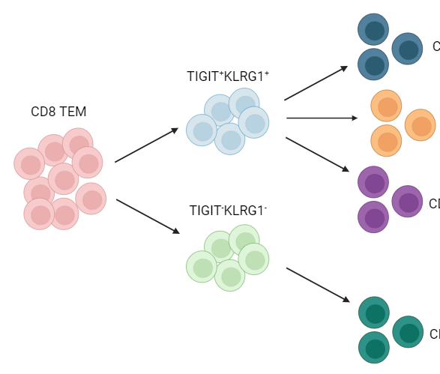
ATACseq from subpopulations of non-naïve CD8s from responders & non-responders to teplizumab (T1D drug)
bulk ATAC-seq of 5 populations (bolded)
TIGIT⁺
KLRG1⁺ (DP)
DP CD57⁺
non-naive
CD8s
DP PD1⁺
Sort 6 responders, TIGIT⁺KLRG1⁺ high
Sort 4 non-responders, TIGIT⁺KLRG1⁺ low
DP CD127⁺
TIGIT⁻KLRG1⁻ (DN)
non-exhausted (not DP) CD127⁺
Months post start of treatment
Responders: < 40% decline in C-
peptide AUC in two years
Notes:
Randomization refers to start of treatment
ATACseq: transposable (Tn5)-mediated insertion of seq adaptors preferentially in accessible chromatin
Presumably chose low DP of NR and high DP of R to hopefully increase signal?
Samples also went to CyTOF
10 samples from anti-CD3 (AbATE) treated T1D, peak of response
Presumed PBMCs
Estimated cell yields (30K sorted cells for bulk ATAC)
Responder = <40% decline in C-peptide AUC in two years, C-peptide biomarks beta cell function (C peptide released in equal amounts to insulin when proinsulin cleaved), AUC just because measuring total C-peptide released over time (multiple measurements), so basically R have less decline in insulin levels i.e. beta cells still secreting insulin (functioning)
Teplizumab: humanized anti-CD3 monoclonal Ab to delay onset of stage 3 T1D in people with stage 2 T1D. mechanism: weak agonist of TCR-CD3 to induce anergy/apoptosis of T cells (i.e. autoreactive Teffs I presume)
KLRG1: co-inhibitory receptor belonging to inhibitory killer cell lectin-like receptors on NK cells and antigen-experienced human T cells, thought to be a senescent marker for human T cells with poor proliferation and impaired clonal expansion after stimulation
CD127 = IL7R

Slide 18
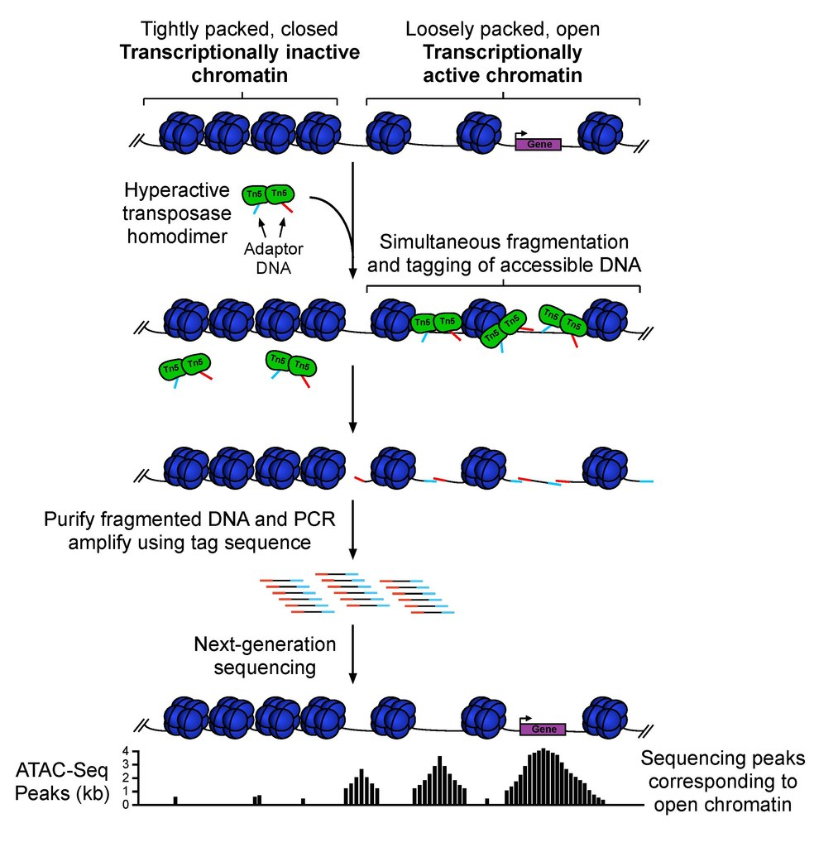
ATACseq methods
ATACseq = assay for transposable-accessible chromatin with sequencing
AtacSeqWorkshop

Slide 19
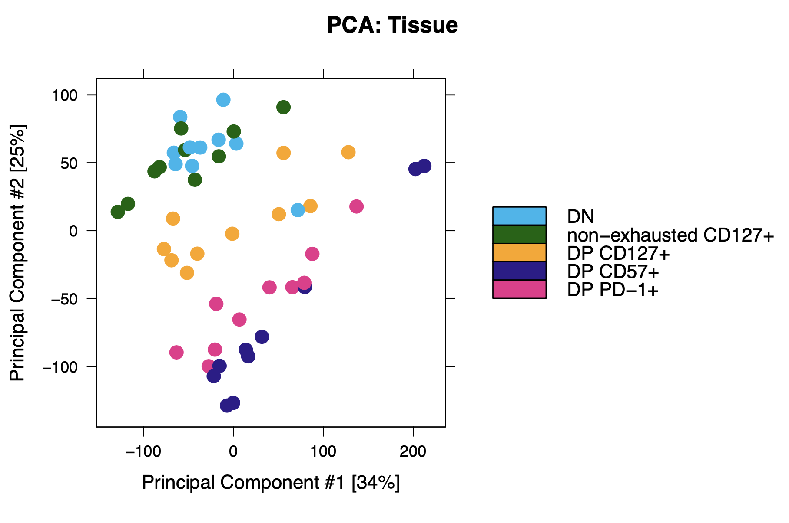
Epigenetic profiles between different cell sorts look distinct
Notes:
Dimensional reduction techniques can help us visually compare different conditions’ based on how accessible their genomes are in different places
PCs are linear combinations of peak scores, %s show % of variance in data captured
Dimensional reduction techniques can take a huge DNA peaks by condition table and condense it into way fewer dimensions that we can visualize (i.e. take 10,000 peaks by 20 conditions combos and condense to show combinations of peaks capturing most variation in data)

Slide 20
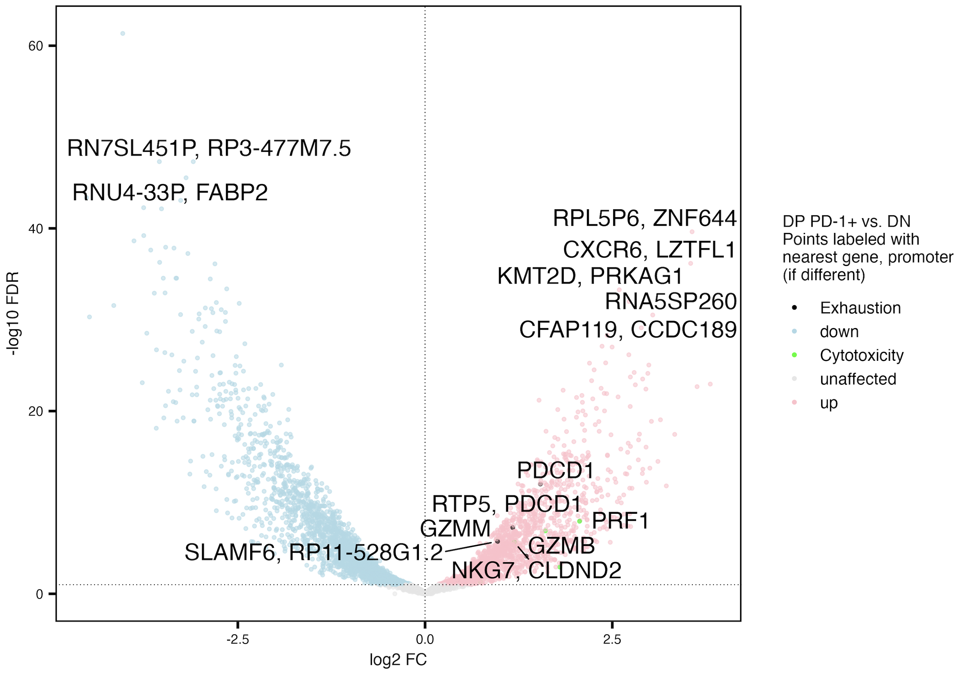
Genomic intervals near cytotoxicity and exhaustion genes more accessible in DP PD-1⁺ vs. DN
TIGIT⁺
KLRG1⁺ (DP)
DP CD57⁺
non-naive
CD8s
DP PD1⁺
DP CD127⁺
TIGIT⁻KLRG1⁻ (DN)
non-exhausted (not DP) CD127⁺
Notes:
Similar to Erin’s P452 T1DAL analyses
Erin’s PD-1 up vs. DN: GZMB, GZMH, LAG3, TBX21, NKG7, CD244, KLRF1
Cytotoxicity up even though “exhausted” because DP is only partially exhausted? And DN can have other exhaustion markers I suppose

Slide 21
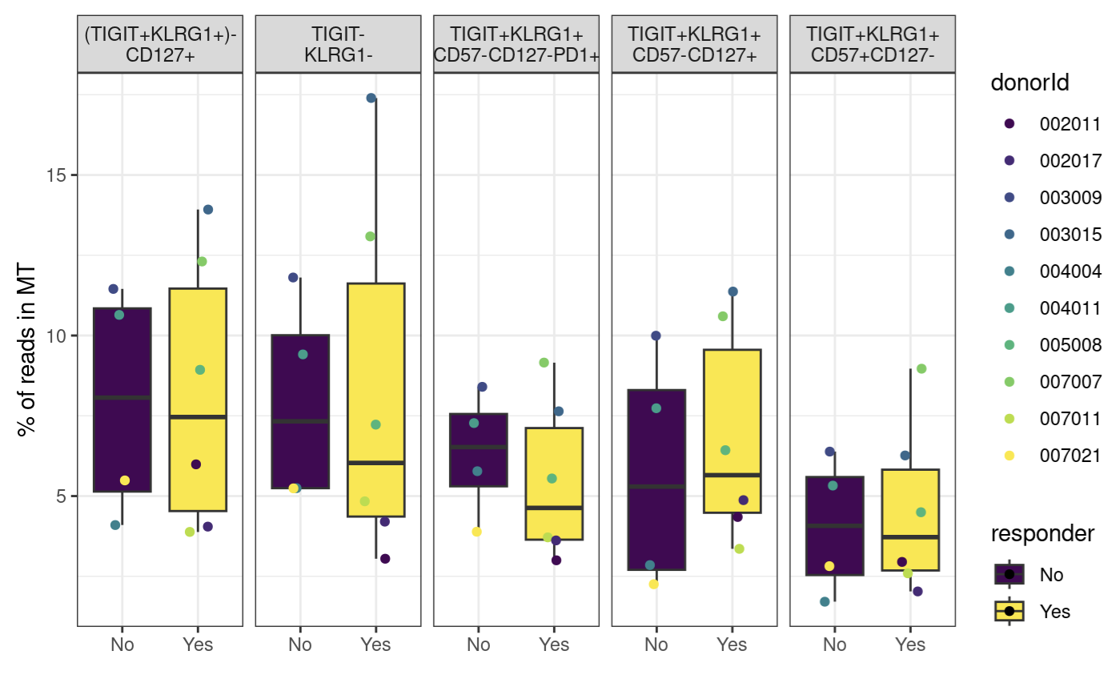
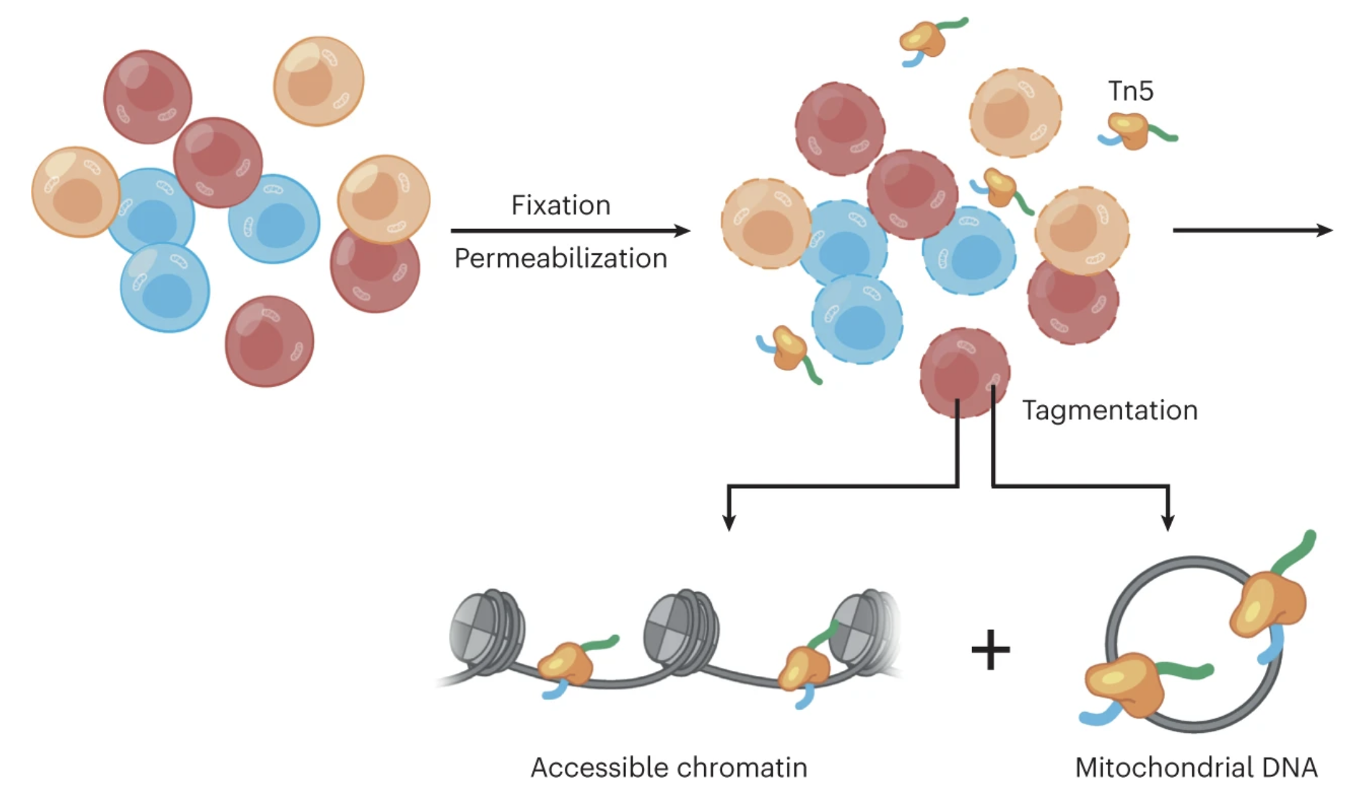
ATACseq yields both nuclear and mitochondrial DNA
Lareau et al. (2023) Nat Protoc
Notes:
MT DNA is very accessible to Tn5 transposase
DNA mutation rate much higher in MT DNA than nuclear DNA
MT mutations are passed down to daughter cells, can help track cell lineages

Slide 22
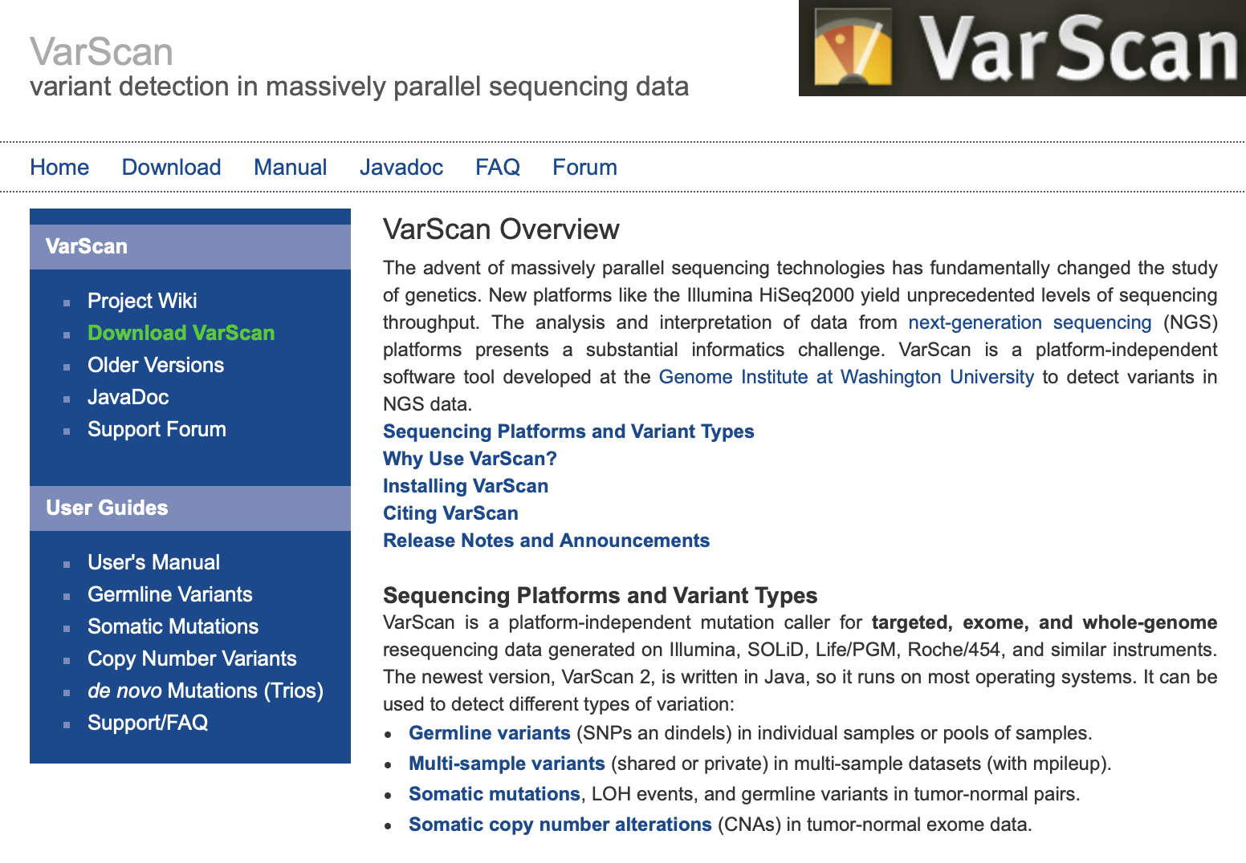
Using VarScan tool to find MT single nucleotide variants
Notes:
Extract MT mapping reads from alignment bam files
Create pileup files (necessary input for Varscan) using samtools
Run Varscan variant caller on each library
Parses pileup input 1 base at a time, computing number of bases supporting each observed allele
Only bases meeting minimum base quality (default: 20) from reads meeting minimum mapping quality (default: 1) are considered
Coverage (number of qualifying bases) is calculated
If coverage meets minimum threshold, then VarScan examines each observed allele to test if it was…
supported by minimum number of supporting reads
Meets minimum allele frequency threshold (min_var_freq)
Passes basic strand-bias filter
Has Fisher’s exact test pval < threshold
Filter out possible seq/mapping errors
VarScan employs a robust heuristic/statistic approach to call variants that meet desired thresholds for read depth, base quality, variant allele frequency, and statistical significance.
Min_coverage param does seem to matter somewhat… with higher value (20 vs. 8), trends seem more extreme, I think this is fine even if 8 is default value as 20 is more stringent…
VarAllele Most frequent non-reference allele observed, this is what I use for sharing analyses

Slide 23
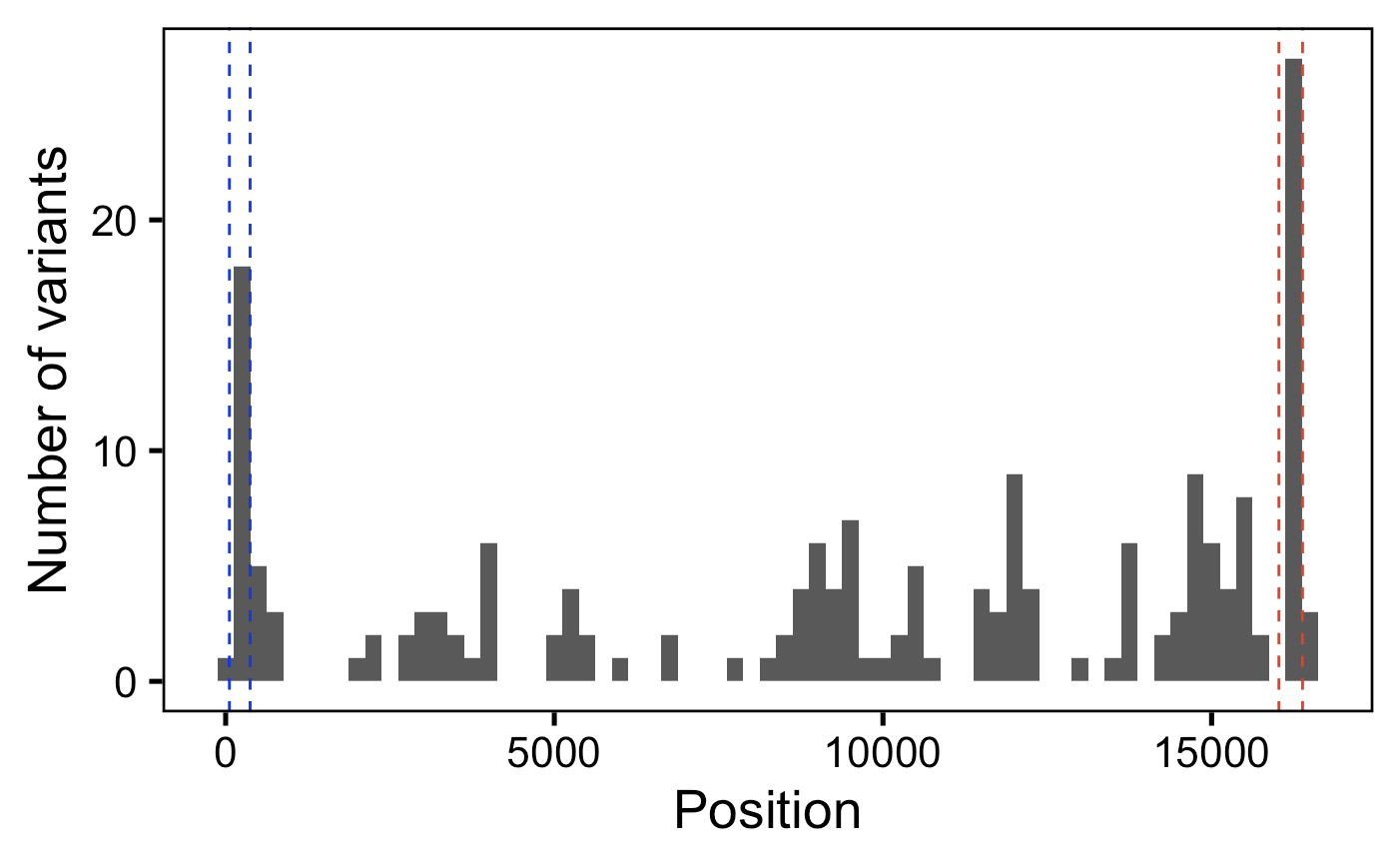
As expected, do observe more MT single nucleotide variants within hypervariable regions
HV2
HV1
Notes:
Variants here are somatic
HVs are mutational hotspots
Min_var_freq = 0.01 for P576 here
Bin width 250 bp

Slide 24
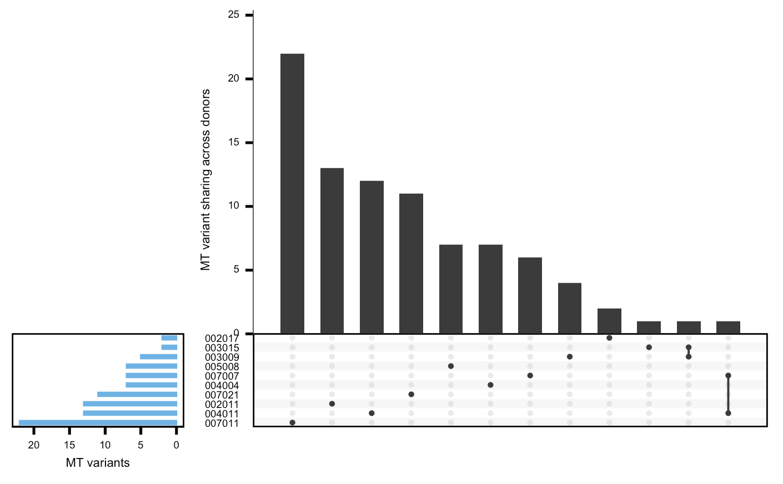
As expected, most MT variants are private within a donor
Donor
ID

Slide 25
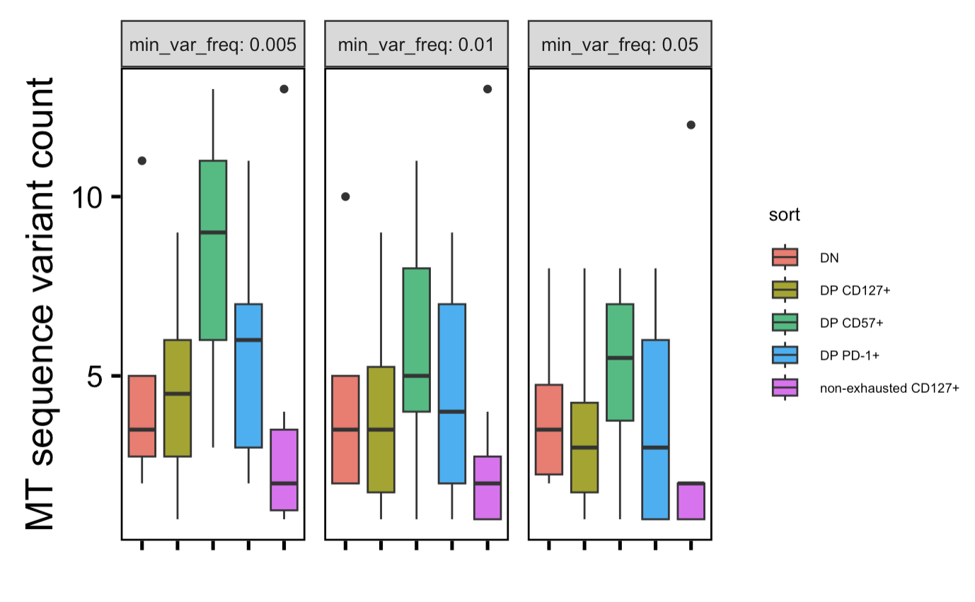
DP CD57⁺ has most MT seq variants, non-exhausted CD127⁺ has fewest
TIGIT⁺
KLRG1⁺ (DP)
*
**
DP CD57⁺
*
non-naive
CD8s
*
*
*
DP PD1⁺
*
DP CD127⁺
TIGIT⁻KLRG1⁻ (DN)
non-exhausted (not DP) CD127⁺
n = 10 (donors)
Wilcoxon rank sum test. **, p < 1e-2; *; p < 0.05
Notes:
non-exh CD127+ having least variants tracks with idea that they're least terminal, more naive, earliest memory
DN may turnover/divide more than I thought so more vars tracks with this
Going too low in min_var_freq may introduce noise, I believe 0.01 is recommended from sample size (0.5/sample of 50)
None of P452 pairwise wilcox tests are significant

Slide 26
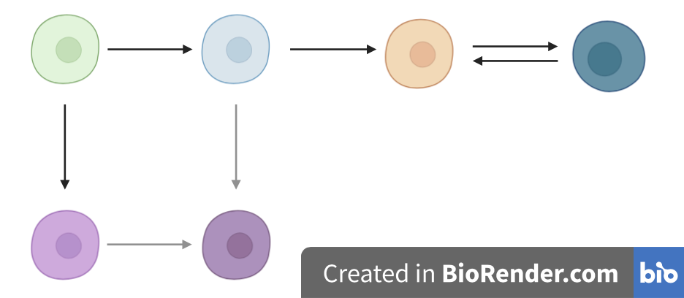
Inferences gained for CD8 differentiation pathway
TIGIT⁻
KLRG1⁻
TIGIT⁺
KLRG1⁺
(DP)
DP PD-1⁺
DP CD57⁺
non-exhausted
CD127⁺
DP
CD127⁺
Notes:
Perhaps ask if there are any (more) bulk/sc RNA/ATACseq datasets at BRI with these cell sorts? Ideally scATACseq (not all mt genome transcribed and coverage worse for RNA due to sequencing biases I think, relatively uniform ATACseq coverage across the mitochondrial genome because of the high accessibility and only modest bias of the Tn5 transposase on native mtDNA)
overarching Qs: if DP (Tex) CD127+ are actually Tex, relations to other Tex and non-exhausted CD127+

Slide 27
Project 2: why do some people on immune checkpoint blockade develop immune-related adverse events (irAEs)?

Slide 28
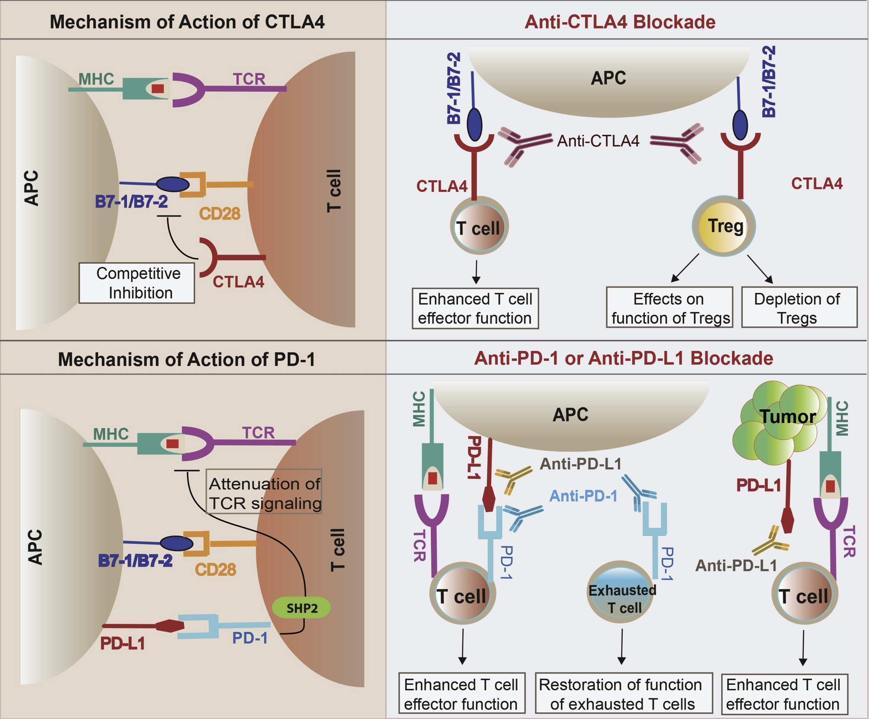
Immune checkpoint blockade (ICB) has revolutionized cancer treatment
Khan et al. Semin Cancer Biol. 2020
Notes:
Script
Immune checkpoint pathways are often activated in cancer, helping tumors evade the immune response
Immune checkpoint blockade acts to block inhibitory checkpoint molecules to enhance immune activity against tumors
Over the last decade, ICB have revolutionized cancer treatment.
CTLA-4 and PD-1/PD-L1 constitute the majority of currently FDA approved ICB drugs.
For example, PD-L1 (PD-1 ligand) expressed on tumor cells, binds PD-1 on T cells to inhibit their activation
Other notes
CTLA-4 expressed on tumor infiltrating Tregs, also activated CD4 T cells, exhausted T cells
CTLA-4 blockade likely acts in draining lymph node where CTLA-4 expressing Tregs
In 2011, ipilimumab (Yervoy) became the first ICI to receive FDA approval for metastatic melanoma. As of 2023, it remains the only CTLA-4 targeting ICI that received FDA approval
Mechanisms of immune-related adverse events during the treatment of cancer with immune checkpoint inhibitors
anti-CTLA-4 and anti-PD-1/PD-L1 antibodies called "immune enhancers" and "immune normalizers" (normalizing T cell immunity in tumor microenvironment), respectively, consistent with PD-1 blockade having less irAEs

Slide 29
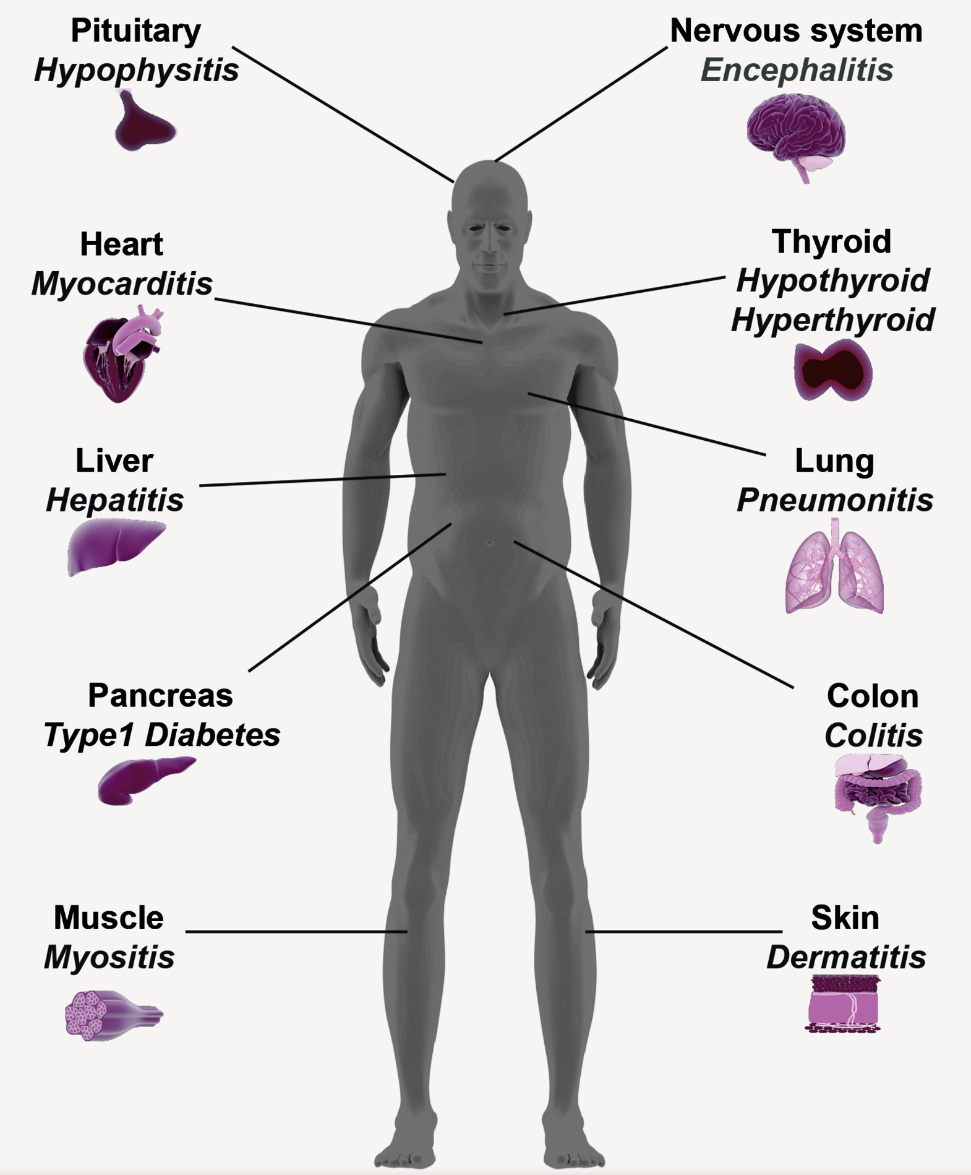
ICB can lead to the development of immune-related adverse events (irAEs)
Khan et al. Semin Cancer Biol. 2020
Notes:
irAEs are autoimmune-like inflammatory pathologies

Slide 30
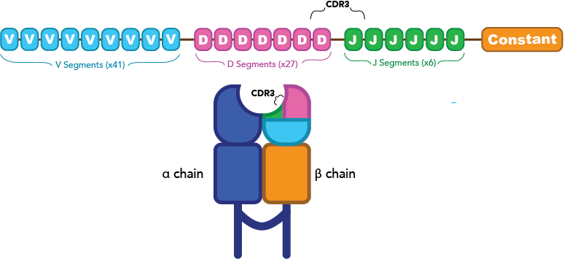
Goals
Determine if T cell receptor features can serve a proxy for or predispose to T cell cross-reactivity (attacking tumor and self) which may cause irAEs
Features to investigate
Junction length (PMID33289628, PMID12152083, PMID9597140), chemical properties (PMID35177831)
TCR germline-ness (probability of generation)
Possible effects of feature variations
Altered TCR-pMHC contact geometry, binding modes, number of contacts
Notes:
"germline-ness score", precisely, it's the probability that the TCR was generated, taking into account V and J gene usage and probabilities of mutations. Higher pgen generally means that it's closer to germline, because the probability of mutation is lower than not mutation, but it's more complicated than that.
Additional possible effect that I’m not sure how to talk about: altered diversity?
Initially thought that more germline-like TCRs might be more cross-reactive as they have lower sequence complexity, don’t fully understand that hypothesis though…
Hydrophobicity: more hydrophobic TCRs might be more cross-reactive as they allow more alternative contacts
Entropic contributions and the influence of the hydrophobic environment in promiscuous protein-protein association: interface demonstrates promiscuity in part due to the number of interactions this hydrophobic interface allows, which allows many alternative contacts (increased entropy, drives forward binding) with other binding partners hence promiscuity
Repertoire analyses reveal T cell receptor sequence features that influence T cell fate
TRB CDR3 hydrophobicity promotes reactivity to self-peptides
Functionally specialized human CD4+ T cell subsets express physiochemically distinct TCRs: longer CDR3s might promote crossreactivity
Statistical analysis of CDR3 length distributions for the assessment of T and B cell repertoire biases:
The length of the CDR3 loop greatly influences its shape and ability to fold both on itself and in the company of others loops such as the CDR1 and CDR2

Slide 31
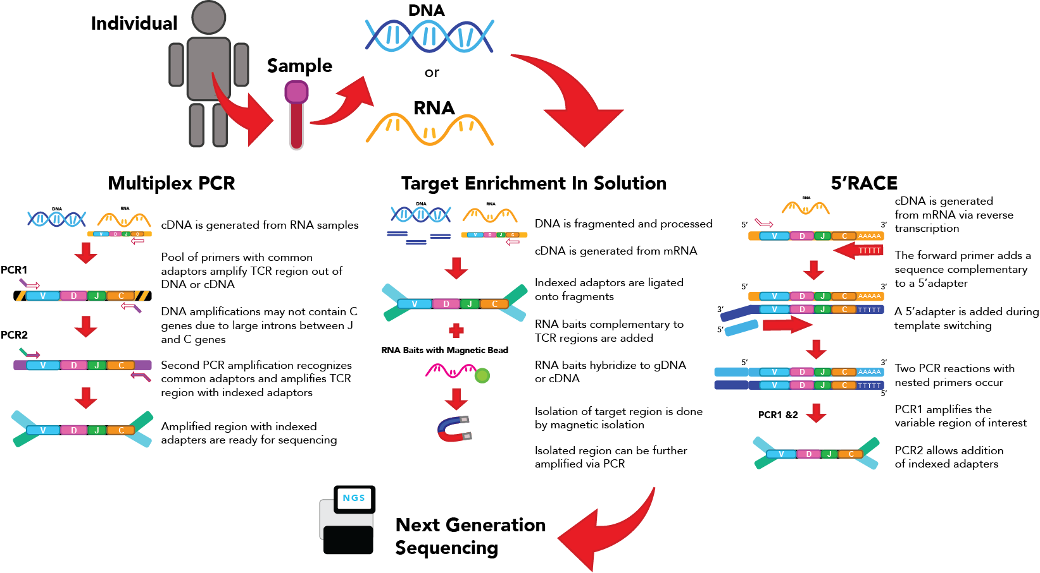

scRNA, T cell receptor sequencing methods
RNA seqblog
Wikipedia

Slide 32


Importing data from 2 public PBMC (peripheral blood mononuclear cell) RNA + TCR datasets with patient irAE tracking info
PBMC myocarditis-focused dataset (~30k T cells)
Colon tissue colitis dataset (~50k T cells)
Use RNA to tell what kind of T cell a cell is, use TCR to ask questions about relationship between TCR and irAE
Notes:
Why I used different cell typing methods
didn’t want to use manual markers (as both papers at least partially did), even though I ended up doing this to get Trms
Mostly agree anyways so it’s not that big of a deal
Worth following up with new cell typing methods perhaps as a next step
4) Cell type abundance differences robust i.e. seen via both methods more interesting to follow up on (i.e. proliferating CD4 Ts)
Ref mapping:
We then find anchors between reference and query.
We then transfer cell type labels and protein data from the reference to the query. Additionally, we project the query data onto the UMAP structure of the reference.

Slide 33

Proliferating CD4 T cell TRB chains from colon tissue colitis dataset are slightly more germline-like in irAE colitis group
*
→
More germline-like
Less germline-like
→
Wilcoxon rank sum test. *, padj < 0.05
Notes:
"germline-ness score”
Precisely, it's the probability that the TCR was generated, taking into account V and J gene usage and probabilities of mutations. Higher pgen generally means that it's closer to germline, because the probability of mutation is lower than not mutation, but it's more complicated than that.

